Slide 1
Future Casting –
The Horizon Report and Beyond
Email: d.j.parkes@staffs.ac.uk
Twitter: @daveparkes

Slide 2
"I think there is a world market for maybe five computers."
Thomas Watson, president of IBM, 1943
"People will soon get tired of staring at a plywood box every night."
Darryl Zanuck, executive at 20th Century Fox, 1946
"Nuclear-powered vacuum cleaners will probably be a reality within ten years."
Alex Lewyt, president of Lewyt vacuum company, 1955
"There is no reason anyone would want a computer in their home."
Ken Olsen, founder of Digital Equipment Corporation, 1977
"I predict the Internet will soon go spectacularly supernova and in 1996 catastrophically collapse."
Robert Metcalfe, founder of 3Com, 1995
"Apple is already dead."
Nathan Myhrvold, former Microsoft CTO, 1997
"Two years from now, spam will be solved."
Bill Gates, founder of Microsoft, 2004

Slide 3
big data, learning analytics, the internet of things, nanotechnology, smart dust, ethics, privacy and surveillance, robotics, regenerative medicine, brain-computer interfacing, greater than human intelligence in computers, augmented humans, transhumanism - the digital industrial revolution

Slide 4
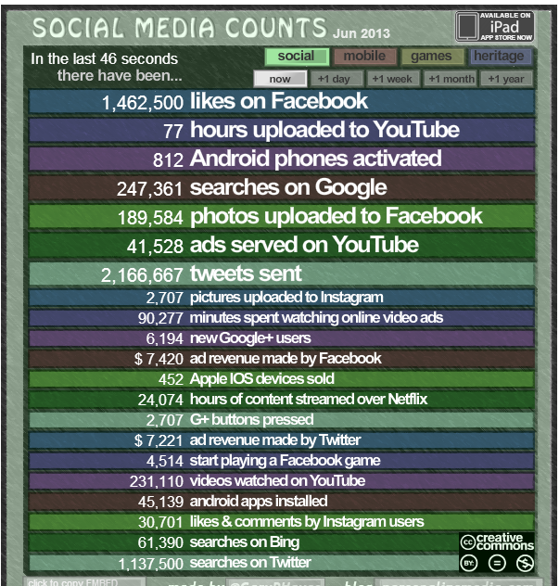
http://www.personalizemedia.com/garys-social-media-count/

Slide 5
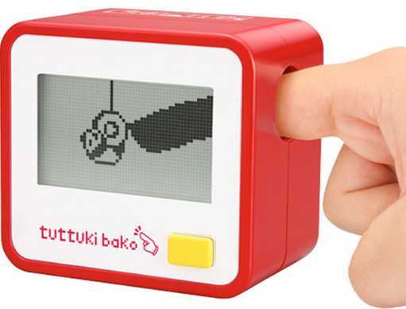

Slide 6
A MEMETIC DISTRIBUTED NETWORK DESPERATELY TRYING TO ACHIEVE COHESION AND SEEK RESOLUTION
cult-ure Rian Hughes

Slide 7
PLEASANTLY MAD PLACES
‘Libraries have always seemed to me pleasantly mad places, and for as long as I can remember I’ve been seduced by their labyrinthine logic.’
Alberto Manguel, The Library at Night

Slide 8
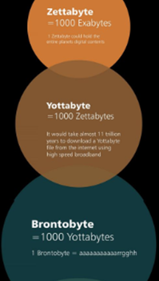
Big Data …Big Data Storage
bit byte kilobyte (kB) = 1,024 bytes megabyte (MB) = 1,024 kB gigabyte (GB) = 1,024 MB terabyte (TB) = 1,024 GB petabyte (PB) = 1,024 TB exabyte (EB or XB) = 1,024 PB zettabyte (ZB) = 1,024 XB yottabyte (YB) = 1,024 ZB

Slide 9
10 times as much data every 12 months
computing power doubles every 18 months
10 times more powerful every 5 years
1000 times better every 15 years
1 billion times over a lifetime

Slide 10
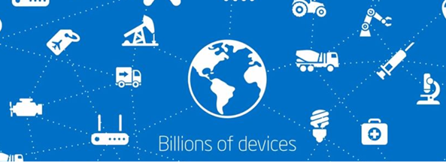
The Internet of Things

Slide 11
Consumer Technologies
Social Media Technologies
Internet Technologies
Visualisation Technologies
Enabling Technologies
Learning Technologies
Tablet
Quantified self
Collective intelligence
Collaborative environments
From glasses to wearables
we need digital strategies for these
VLE
PLE
Next gen batteries
Wireless power
3D printing
Information Visualisation

Slide 12
3D Video
Electronic Publishing
Mobile Apps
Quantified Self
Tablet Computing
Telepresence
Wearable Technology
BYOD
Flipped Classroom
Games and Gamification
Location Intelligence
Makerspaces
Preservation and Conservation Technologies
Cloud Computing
The Internet of Things
Real-Time Translation
Semantic Applications
Single Sign-On
Syndication Tools
Badges/Microcredit
Learning Analytics
Mobile Learning
MOOCs
Online Learning
Open Content
Open Licensing
Personal Learning Environments
Virtual and Remote Laboratories
Collaborative Environments
Collective Intelligence
Crowdfunding
Crowdsourcing
Digital Identity
Social Networks
Tacit Intelligence
3D Printing/Rapid Prototyping
Augmented Reality
Information Visualization
Visual Data Analysis
Volumetric and Holographic Displays
Affective Computing
Cellular Networks
Electrovibration
Flexible Displays
Geolocation
Location-Based Services
Machine Learning
Mobile Broadband
Natural User Interfaces
Near Field Communication
Next-Generation Batteries
Open Hardware
Speech-to-Speech Translation
Statistical Machine Translation
Virtual Assistants
Wireless Power

Slide 13
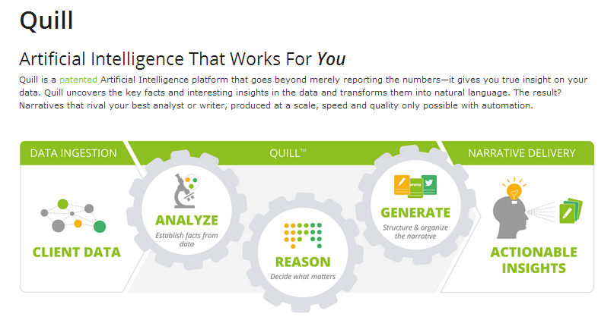
http://www.narrativescience.com/

Slide 14
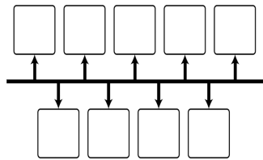
READ - scan and study things outside and beyond your profession
Industry, Art, Museums, Design, Leisure, History
To date 200,000 years of human activity spent on Flappy Bird
ENGAGE – ask questions – talk – share
UX - what changes are taking place, what examples/exemplars who is leading? What is being talked about? What are the cycles of change, when?
CREATE - opportunities and the environment to discuss and share , create a vision
The gap between vision and reality engenders a creative tension
FRAME- ideas – metaphors, language, behaviours, social
CHALLENGE - assumptions don’t offer predictions
TECHNOLOGY- The future is not determined by its technologies
Thinking about the future always involves values and politics
The future influences the present just as much as the past - Neitzsche
Tactics for futures thinking…
NOW
THEN

Slide 15
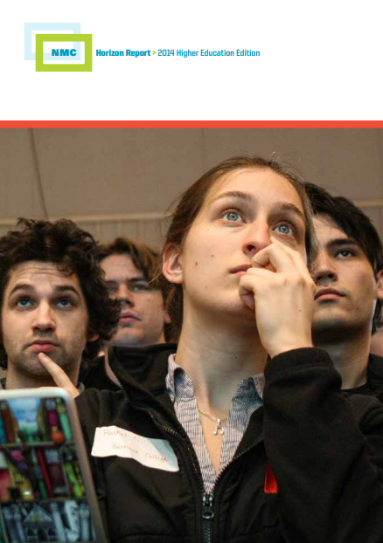
NMC Horizon Report: 2014
Higher Education Edition
NMC Horizon Report: 2014
Library Edition

Slide 16
NMC Horizon Report: 2014 Higher Education Edition
Fast Trends
1 year or less
BYOD
Mid Range
2-3 years
3D Printing
Games and Gamification
Long Range
4-5 years
Virtual Assistants
Quantified Self
Learning Analytics
Flipped Classroom
MOOCs
The Internet of Things
Wearable Technology
Affective Computing
Flexible Displays

Slide 17
NMC Horizon Report: 2014 Library Edition
Fast Trends
1 year or less
Mid Range
2-3 years
The Evolving Nature of the Scholarly Record
Increasing Accessibility of Research Content
Long Range
4-5 years
Continual Progress in Technology, Standards, and Infrastructure
Rise of New Forms of Multidisciplinary Research
Prioritisation of Mobile Content and Delivery
Increasing Focus on Research Data Management

Slide 18
NMC Horizon Report: 2014 Library Edition
Significant Challenges Impeding Technology Adoption in Academic and Research Libraries
Solvable Challenges
those which we understand and know how to solve
Difficult Challenges
well understood but with solutions that are elusive
Capturing and Archiving the Digital Outputs of Research as Collection Material
Competition from Alternative Avenues of Discovery
Wicked Challenges
complex to define and to address
Embracing the Need for Radical Change
Maintaining Ongoing Integration, Interoperability, and Collaborative Projects
Rethinking the Roles and Skills of Librarians
Embedding Academic and Research Libraries in the Curriculum

Slide 19
NMC Horizon Report: 2014 NMC Horizon Report: 2014 Library Edition
Important Developments in Technology for Academic and Research Libraries
Fast Trends
1 year or less
Mid Range
2-3 years
Bibliometrics and Citation Technologies
Open Content
Long Range
4-5 years
The Internet of Things
Semantic Web and Linked Data
Mobile Apps
Electronic Publishing

Slide 20
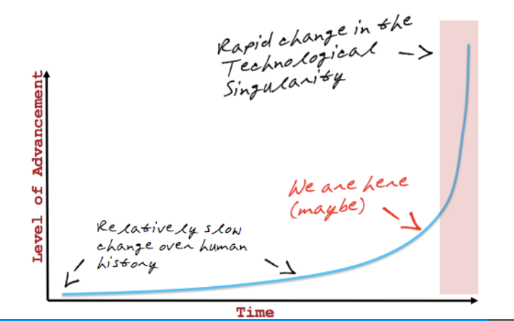

Slide 21
